Slide 1
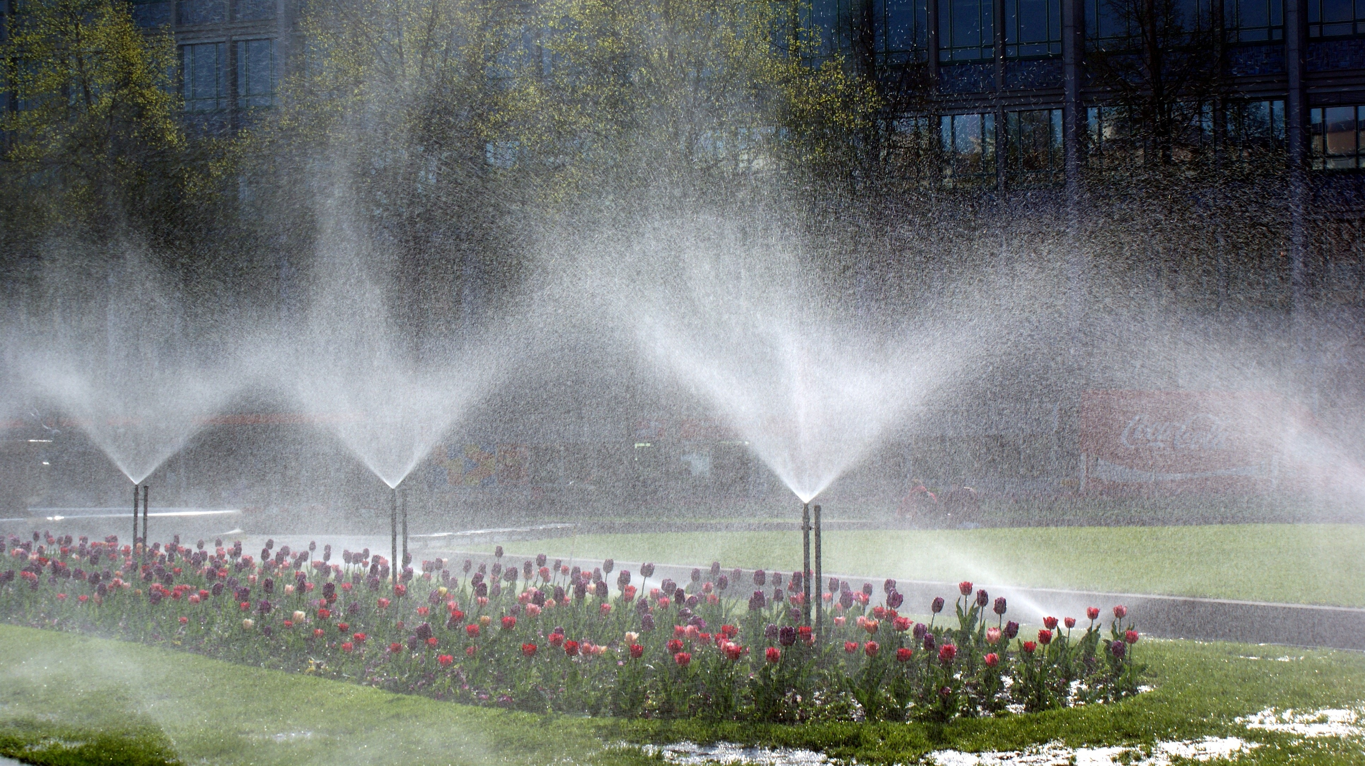
Water Level detector and automated irrigation System

Slide 2



About our Group
Abdullah al shafi
Abrar Hasan
PARTHO CHOUDHURY SHOUMYA
ROLL: 1807004
SEC: A
YEAR: 3rd
SEMESTER: 1st
ROLL: 1807024
SEC: A
YEAR: 3rd
SEMESTER: 1st
ROLL: 1807021
SEC: A
YEAR: 3rd
SEMESTER: 1st

Slide 3

Introduction
Water is a vital element of our nature. But in the agricultural sector in Bangladesh water is vastly misused. About 800 liters of water is wasted for cultivating just 1kilogram of Paddy!
Almost every house in Bangladesh has a water tank. We use a motor pump to pump the water from the surface and store them in the tank. But people often forget to switch off the motor even after tank is filled up. Besides, lots of water get wasted after tank is filled up. Thus one of most important resource of life get wasted.
To tack these issues we planned to make the irrigation process and tank filling process automated, which will not only lessen the burden on people but also will save a lot of water from being wasted.

Slide 4
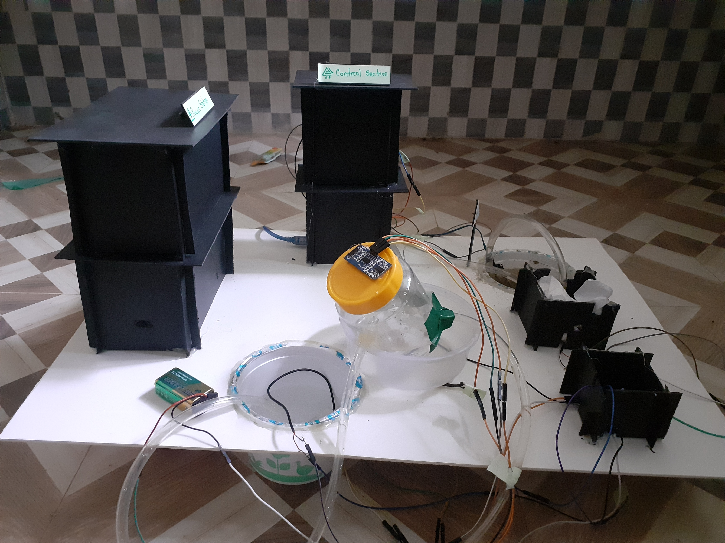
Introducting Project Water Level detector and automated irrigation System

Slide 5
DESCRIPTION
This system senses level of water present in the tank. If the level falls below a predefined point, motor gets started automatically and continue to fill the tank until the level of water reaches a satisfactory level.
Secondly, it calculates moisture of soil using ‘moisture sensor’. If this moisture level falls below minimum level, then another motor gets started and fetches water from the tank to the field till moisture level reaches the expected level.
We used PVC boards, bottles and pots to replicate real world scenario in this project by making buildings, tanks, fields and shades. Different kinds of wires were used to connect all of these.

Slide 6
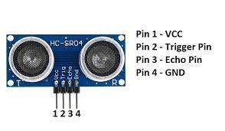
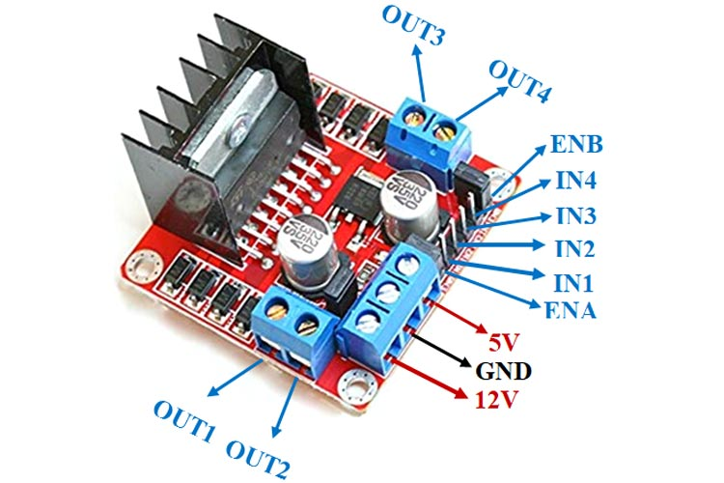
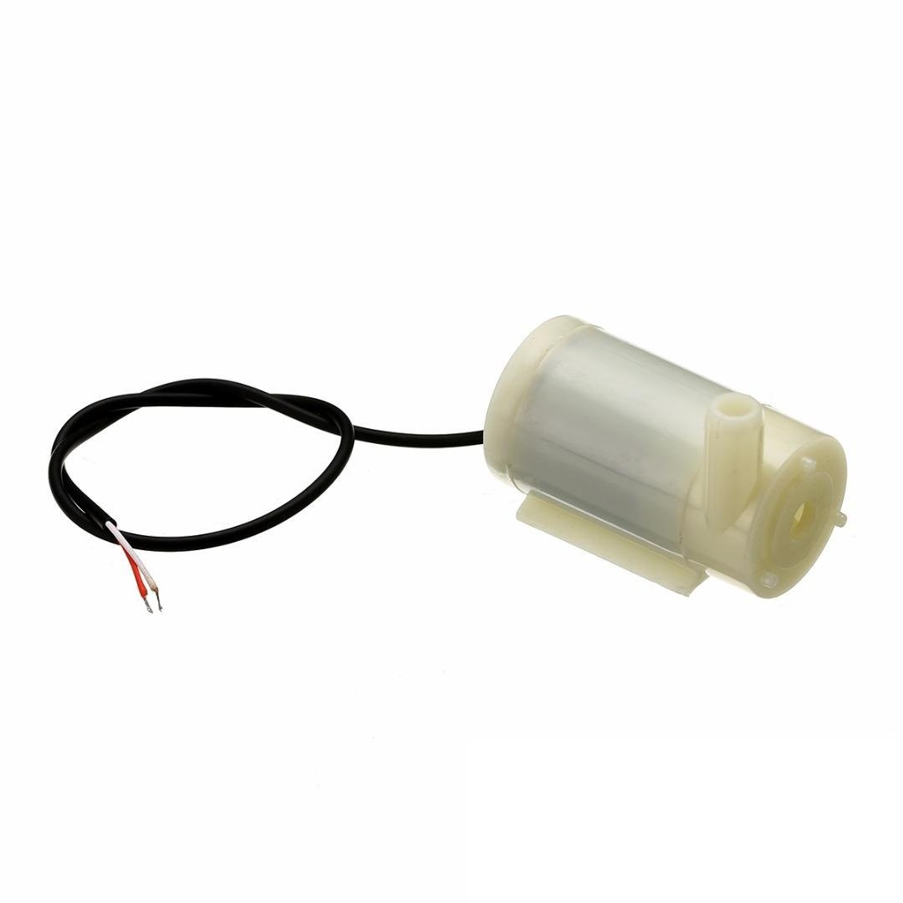
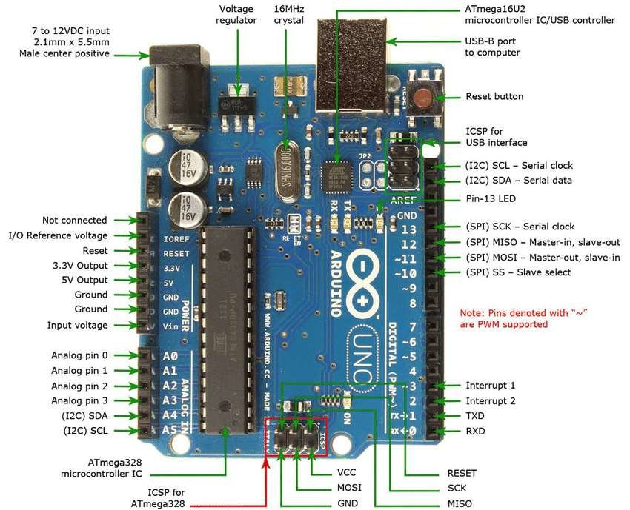
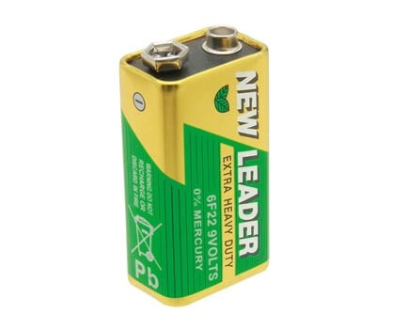

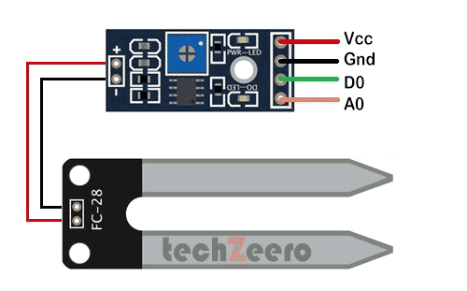
MAIN COMPONENTS used
Arduino (UNO)
SONAR sensor
Motor Driver
Water Pump (2)
Soil Moisture sensor
Battery
Power Bank

Slide 7
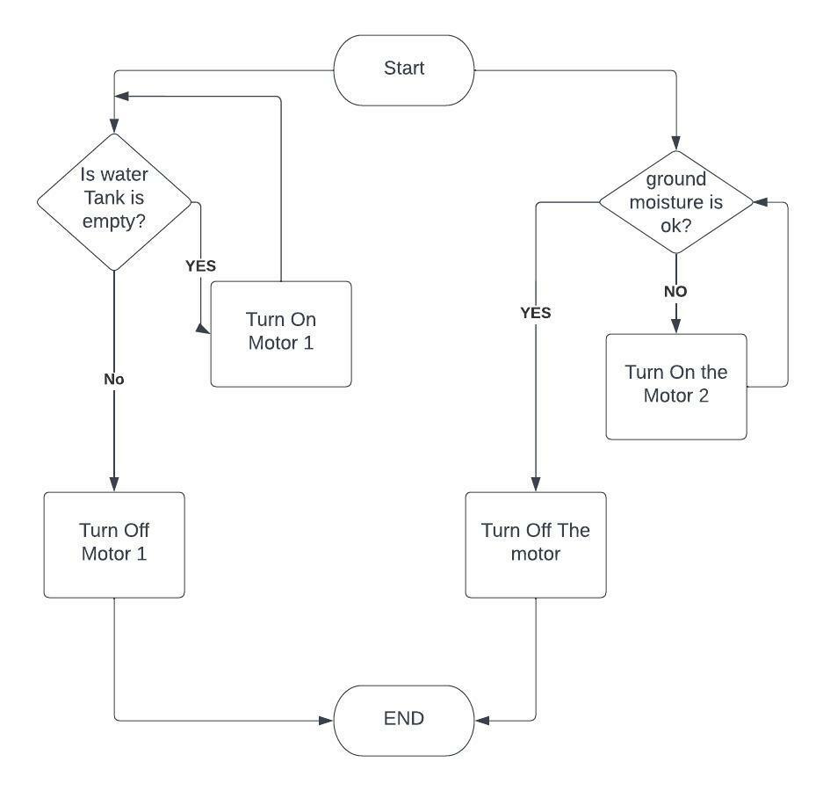
Flow chart

Slide 8
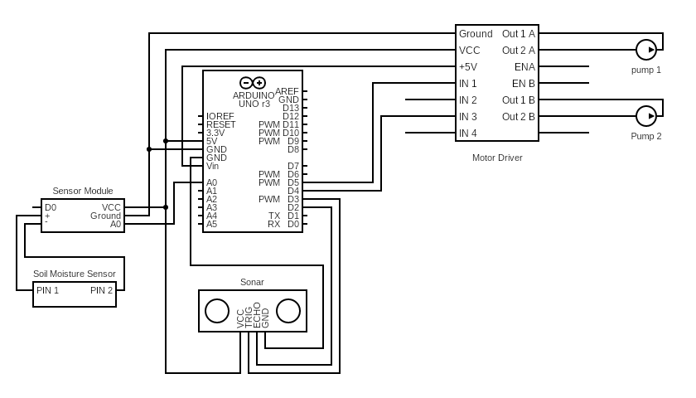
Circuit Diagram

Slide 9
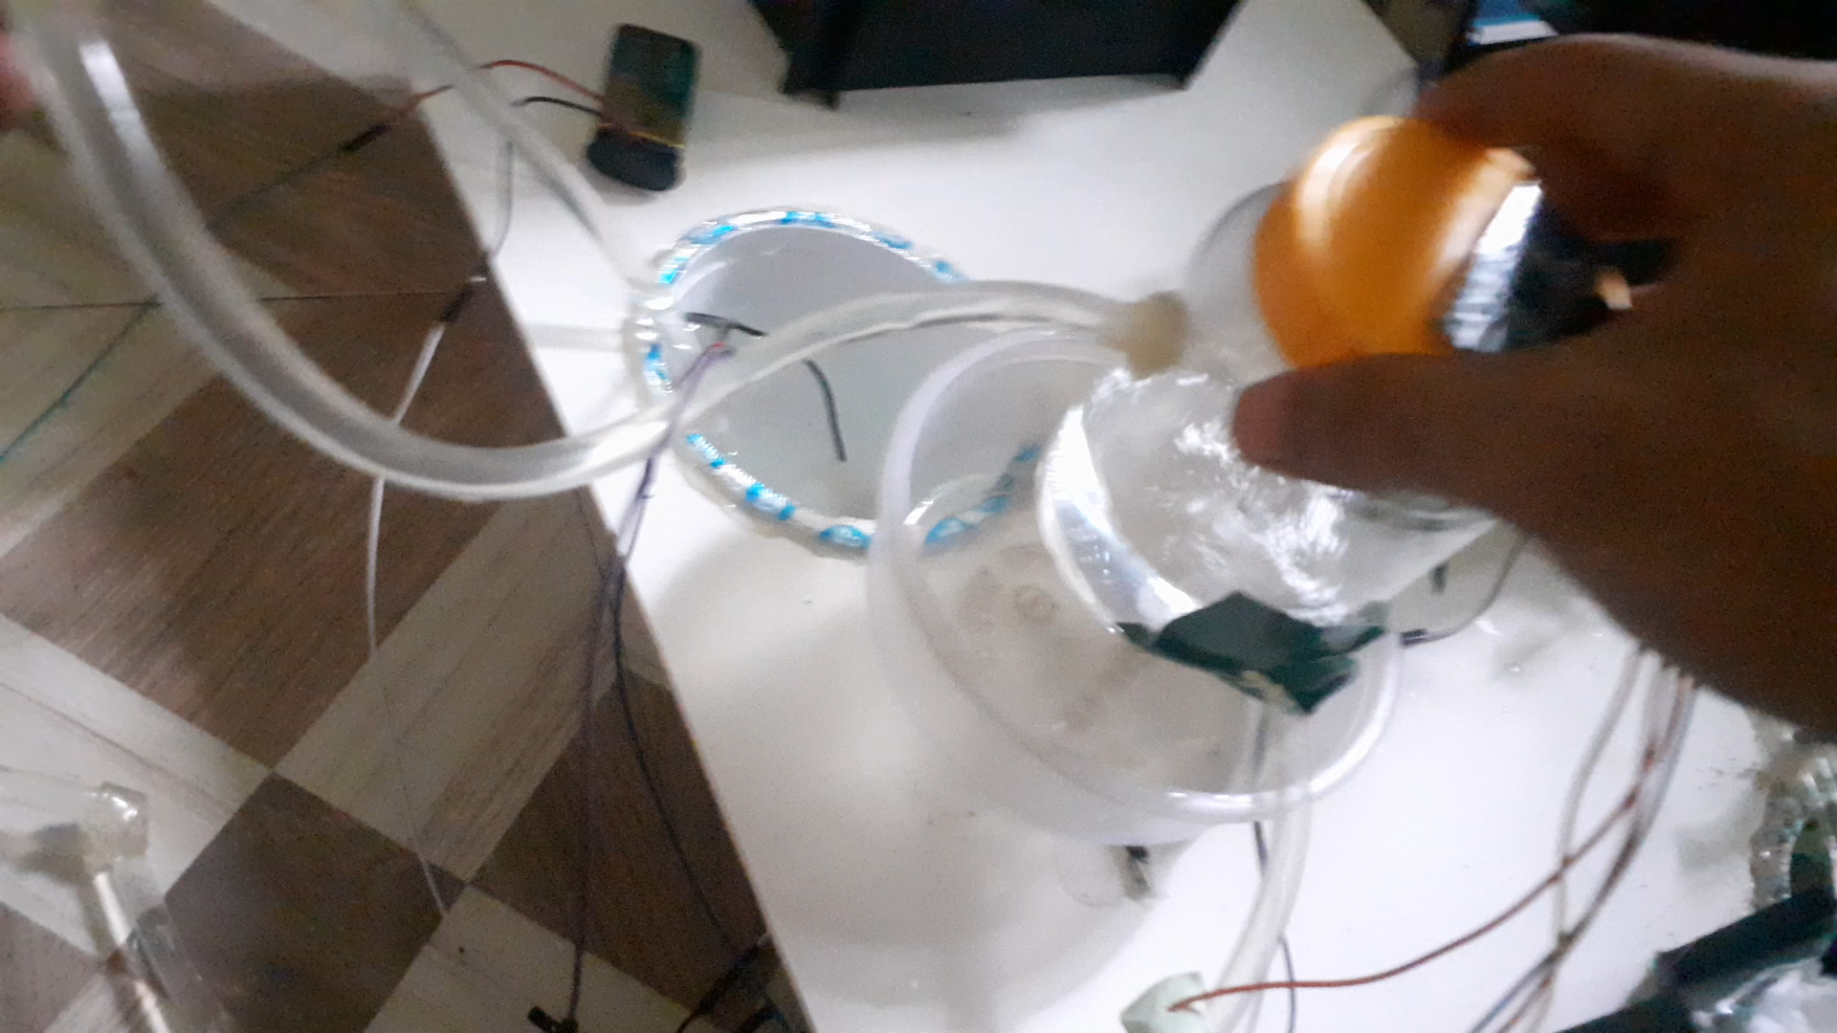

Demonstration of functionality
Firstly, water tank is filled up due to insufficient water in the tank
Then irrigation process starts automatically.

Slide 10
WATER LEVEL DETECTOR AND AUTOMATED IRRIGATION SYSTEM
To summarize, we can clearly see that out project depicts a practical solution to two of the most triggering problems of our country.
It can smoothly detect water level and irrigate crop lands. Surely its vast usage will lessen farmers’ hardship and enable us to use water more efficiently.
The system is cheap, automated, helpful and environment-friendly.

Slide 11
Thank you!

